Slide 1

Mini Project-II (AI101B) Even Semester Session 2024-25
IRIS FLOWER CLASSIFICATION
Devansh Batta 242610116100058
Anurag Singh Kushwaha 242610116100039
Chitransha Bhatt 24261011610054
Bhavna Rajput 242610116100049
Project Supervisor:
Apoorv Jain
Assistant Professor

Slide 2
Content
Introduction (1 slide)
Literature Review (1 slides)
Objective of the Project (1 slide)
Technology
Hardware Requirements (Development Environment, Server requirement (if required), Client requirement (if required).
Software Requirements (Language and Platforms like Frameworks, VS code, Android Studio and Jupyter notebook etc. )
Modules (2 slides)
Workflow (1 slide)
Reports (For Example: Project : Student Monitoring System, so reports like: Student Marks, Subjects, companies visit, and student appears in placement etc.)
References (1 slide)
Notes:
Font Styles: Times New Roman + Font Size: 25

Slide 3
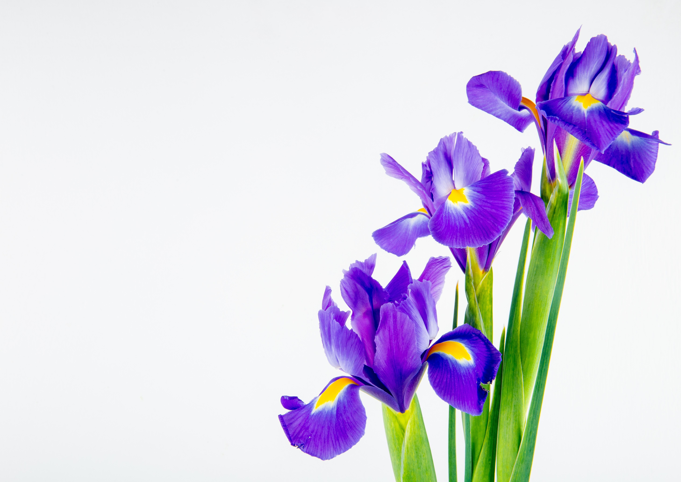
Introduction
The Iris Flower Classification is a machine learning task that categorizes iris flowers into one of three species:Setosa, Versicolor, and Virginica, based on four key features—sepal length, sepal width, petal length, and petal width.
This project focuses on implementing a supervised learning approach to train a classifier that can accurately predict the species of a flower based on its measured attributes.
The classification problem is solved using the K-Nearest Neighbors (KNN) algorithm, known for its simplicity and effectiveness in handling small datasets.
The Iris Flower Classification is a machine learning task that categorizes iris flowers into one of three species:
Setosa, Versicolor, and Virginica, based on four key features—sepal length, sepal width, petal length, and petal width.
This project focuses on implementing a supervised learning approach to train a classifier that can accurately predict the species of a flower based on its measured attributes.
The classification problem is solved using the K-Nearest Neighbors (KNN) algorithm, known for its simplicity and effectiveness in handling small datasets.
Notes:
Font Styles: Times New Roman + Font Size: 25

Slide 4

Literature Review
The Iris dataset was introduced by British statistician Ronald Fisher in 1936 as a multivariate dataset for discriminant analysis.
It has been widely used for testing various classification algorithms such as K-Nearest Neighbors (KNN), Decision Trees, and Support Vector Machines.
The dataset’s simplicity and balance make it a common choice for machine learning model evaluation and visualization.
Various studies have explored feature selection techniques, comparing linear and non-linear models for improved accuracy.
Modern deep learning approaches have also been tested on the dataset, though traditional machine learning techniques remain dominant due to the dataset's small size.
The Iris dataset was introduced by British statistician Ronald Fisher in 1936 as a multivariate dataset for discriminant analysis.
It has been widely used for testing various classification algorithms such as K-Nearest Neighbors (KNN), Decision Trees, and Support Vector Machines.
The dataset’s simplicity and balance make it a common choice for machine learning model evaluation and visualization.
Various studies have explored feature selection techniques, comparing linear and non-linear models for improved accuracy.
Modern deep learning approaches have also been tested on the dataset, though traditional machine learning techniques remain dominant due to the dataset's small size.
Notes:
Font Styles: Times New Roman + Font Size: 25

Slide 5
Objective of the Project
To develop a classification model that accurately predicts the species of an iris flower based on its features.
To perform exploratory data analysis (EDA) to understand feature relationships.
To implement and optimize the K-Nearest Neighbors (KNN) algorithm for classification.
To evaluate model performance using accuracy, confusion matrix, and classification reports.
To visualize decision boundaries for better interpretability of classification results.
To compare the performance of different classification algorithms such as KNN, Decision Trees, and Logistic Regression.
Notes:
Font Styles: Times New Roman + Font Size: 25

Slide 6
Technology (Hardware Requirements)
Processor: Intel Core i3 or higher
RAM: 4GB or more
Storage: 10GB free disk space
Notes:
Font Styles: Times New Roman + Font Size: 25

Slide 7
Technology (Software Requirements)
Programming Language: Python
Development Environment: Jupyter Notebook, VS Code
Libraries: NumPy, Pandas, Matplotlib, Seaborn, Scikit-Learn
Frameworks: TensorFlow (for advanced exploration), Scikit-Learn (for model implementation)
Tools: Google Colab (for cloud-based implementation), Anaconda (for local execution)
Notes:
Font Styles: Times New Roman + Font Size: 25

Slide 8
Modules
Data Preprocessing
Load the dataset
Handle missing values (if any)
Encode categorical variables
Exploratory Data Analysis (EDA)
Summary statistics
Pair plots and heatmaps for feature correlation
Data Splitting and Normalization
Train-test split (80-20)
Feature scaling to normalize data
Notes:
Font Styles: Times New Roman + Font Size: 25

Slide 9
Modules (Contd.)
4.Model Training and Hyperparameter Tuning
Implement KNN classification
Use GridSearchCV to find the optimal K value
Compare performance with Decision Trees and Logistic Regression
5.Evaluation and Visualization
Compute accuracy, confusion matrix, and classification report
Visualize decision boundaries for better interpretability
Plot precision-recall curves and ROC curves for performance analysis
Notes:
Font Styles: Times New Roman + Font Size: 25

Slide 10
Workflow/Gantt Chart
Load and preprocess the dataset.
Perform EDA to explore feature relationships.
Split the dataset into training and testing sets.
Apply feature scaling.
Train the KNN model and optimize hyperparameters.
Compare KNN with Decision Trees and Logistic Regression.
Evaluate model performance using classification metrics.
Visualize decision boundaries for model interpretability.
Notes:
Font Styles: Times New Roman + Font Size: 25

Slide 11
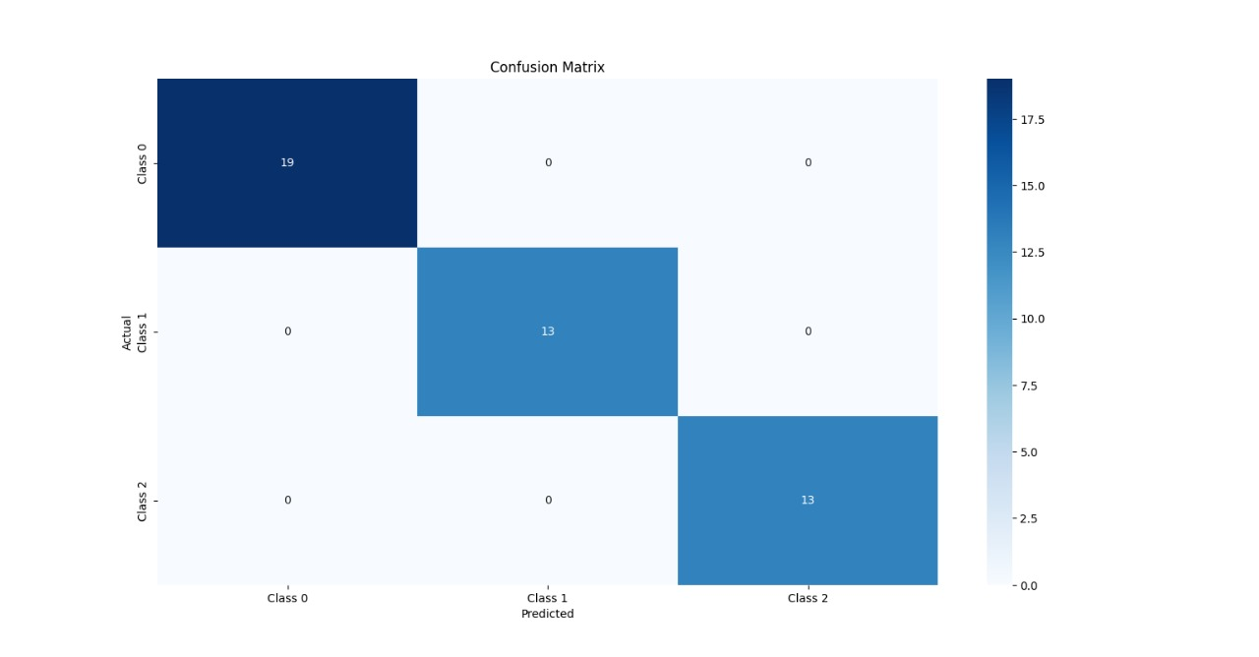
Reports
Model accuracy and classification performance.
Confusion matrix showcasing correct and incorrect predictions.
Feature importance and correlation heatmap.
Decision boundary visualization of the classifier.
Comparative analysis of different classification models.
Insights from ROC and precision-recall curves.
Notes:
Font Styles: Times New Roman + Font Size: 25

Slide 12
References
Scikit-learn documentation: https://scikit-learn.org/
Machine Learning with Python by Andreas C. Müller and Sarah Guido.
TensorFlow documentation: https://www.tensorflow.org/
Python Data Science Handbook by Jake VanderPlas.
Notes:
Font Styles: Times New Roman + Font Size: 25

